Slide 1


K.RAMAKRISHNAN COLLEGE OF TECHNOLOGY
(AUTONOMOUS), TRICHY.
DEPARTMENT OF
COMPUTER SCIENCE AND ENGINEERING
20CS5501 DESIGN PROJECT-1
Batch No. : 19
Date : 05.12.2024

Slide 2
INTEGRATED RESORT BOOKING FOR VOYAGE
Guided by Team
Dr. C. Shyamala M.E.,Ph.D., Dharshini S S(811722104030)
HEAD/IT Dheetshika R(811722104032)
Gayathri M(811722104042)

Slide 3
OBJECTIVE OF THE PROJECT
To enhance the customer experience by providing an user-friendly interface.
To automate operational efficiency for booking ,scheduling and payment processing to reduce the manual errors and save the time.
To implement real-time tracking of bookings ,availability and changes to ensure the customers.
To allow the customer to easily book resort and manage the tours.
To ensure hassle-free and enjoyable experience for travellers.

Slide 4
ABSTRACT
The Project Tour Management System is designed to streamline and enhance the experience of managing and booking tours .This system integrates a variety of essential features aimed at both users and administrators to ensure seamless interaction. This platform begins with a secure login functionality, user registration form, payment processing and currency convertor .This ensures data integrity, efficient retrieval and enhances the overall user experience for managing tours and payments. This project aims to provide an intuitive ,user-friendly platform to facilitate global tour bookings while managing different currencies and travel preferences efficiently.

Slide 5
LITERATURE SURVEY
TITLE OF THE PAPER | AUTHOR (S) | PUBLISHER | PAPER GIST | TECHNOLOGY USED
Resort booking management system | John Doe | Tech press publisher | Booking modules | HTML,CSS,PHP,MYSQL
Efficient tour management solution | Alice Johnson | Travel tech books | Local guides features | ANGULARNODE.JS, MONGODB
Modern website development | David Miller | Webworks publishing | Web accessing | HTML5,CSS3,JS
Literature review on tourism and resort management | Sarah Thomson | Academic press | Literature reviews and references | GOOGLESCHOLAR, JSTOR,SCOPUS
Technology Acceptance models in tourism and hospitality research | Ivett vargane galicz | Journal of environmental management and tourism | Technology Acceptance Model | TAM, Social media ,mobile applications

Slide 6
PROPOSED SYSTEM ARCHITECTURE
Country, date &book
Booking the details
Choose the country
Visiting the website
Choosing the country
Stored successfully in the database
Name, dob, date of travel , no of people
Database
repository
Stored and notify
Filling the details
Cash holder name, cvv no, card no, expiry date
Currency convertor
proceed
Payment process
Currency exchanges

Slide 7
EXISTING SYSTEM ARCHITECTURE
Visiting the website
Booking the details
Stored in repository and notify
Choosing the country
Database
repository
Admin panel
Filling the details
Payment process
Automative storage in database

Slide 8
SOFTWARE AND HARDWARE REQUIREMENTS
HARDWARE
SOFTWARE
Windows
visual studio code
Html,Css
SQLite
python
Intel core processor I5
cloud storage
high speed internet
RAM-8GB
web browser

Slide 9
MODULES
USER MANAGEMENT - registration and login, access control, user dashboard with booking history.
RESORT BOOKING - search and filter option for resorts, room availability and pricing, reservation management with booking confirmation .
TOUR MANAGEMENT - display and filter available tours, tour scheduling and booking, tour confirmation and any changes management.
PAYMENT - payment gateways, invoice generation and management, refunds and cancellation policies , waiver policy.
CURRENCY CONVERTOR – convert currency from one to another via rupee, USD ,Pound etc..

Slide 10
SUMMARY OF MODULE-1
USER MANAGEMENT MODULE
1.It is responsible for handling all user related interaction from
registration to login to manage the profiles and access control.
2.It enable the users to manage and update their personal information
and preferences within the system.
Registration
login
Access control
Dashboard with booking

Slide 11
SUMMARY OF MODULE-2
RESORT BOOKING MODULE
1.It allows the customers to search ,filter and book resort in real-time
2.Once the booking is made the module manages the reservation
including booking confirmation , payment processing and modification
or cancellation is needed
Search and filter
Images facilities
No of rooms
bookings

Slide 12
SUMMARY OF MODULE-3
TOUR MANAGEMENT
1.Administratiors and service providers can create tour packages that includes details like destination activities and duration.
2.It ensures all services like accommodation, transportation ,meals and rooms are confirmed.
view
customize
book
confirm

Slide 13
SUMMARY OF MODULE-4
PAYMENT MODULE
1.It supports various payment method like credit or debit cards bank
transfer and mobile wallets. It ensures customers can pay through their
preferred method improving user satisfaction.
2.It contains secure transaction processing and detect fraud mechanisms
and ensure transparency by generating invoice and sending payment
confirmation.
Select and enter
Generate and review
response
maintain

Slide 14
SUMMARY OF MODULE-5
CURRENCY CONVERTOR
1.It ensures that the budget is managed effectively and there are no financial discrepancies.
2.It provides up-to-date exchange rates, making it easier to charge and settle payments in different currencies.
Enter amount
From
conversion
To
conversion
Successfully
converted

Slide 15
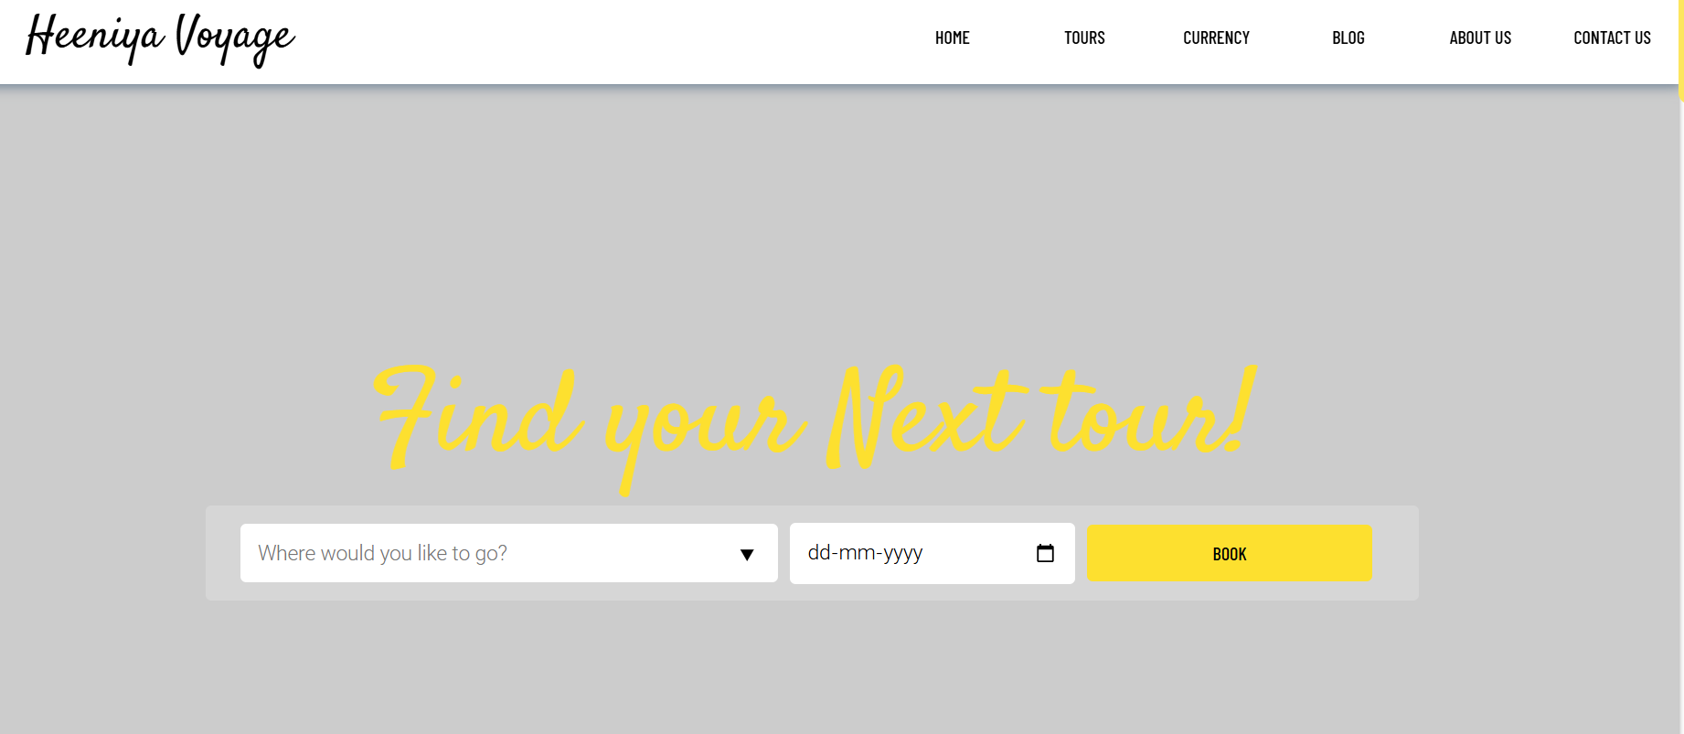
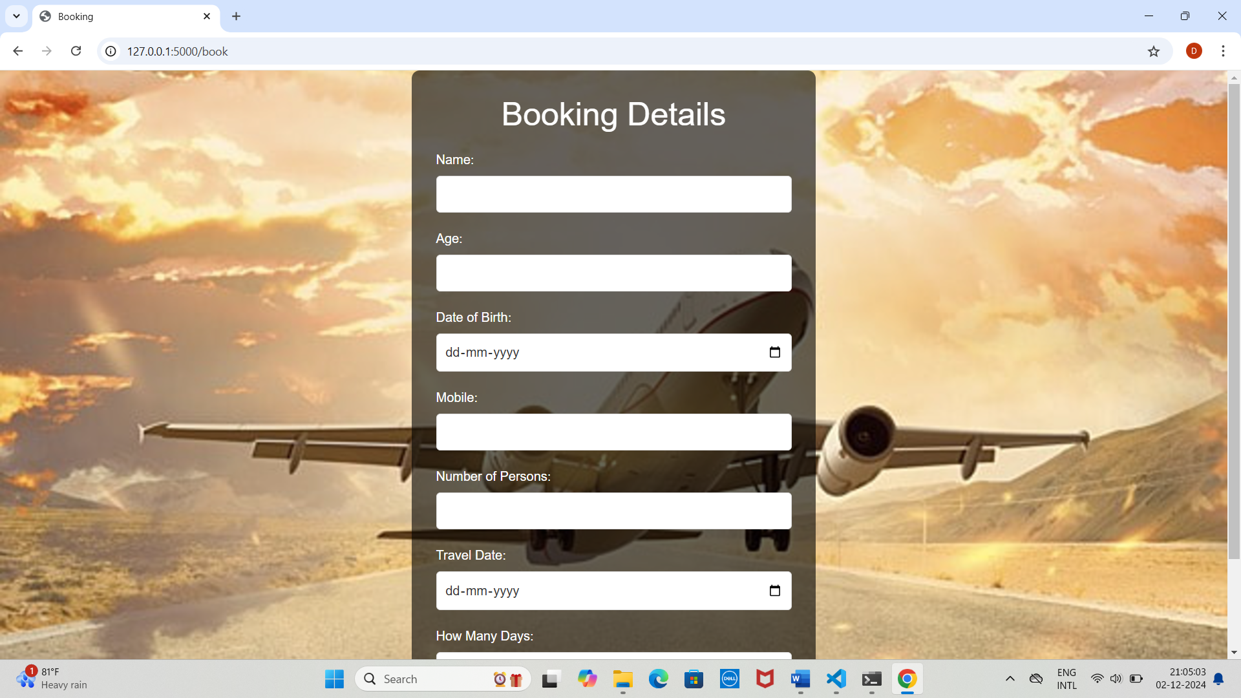
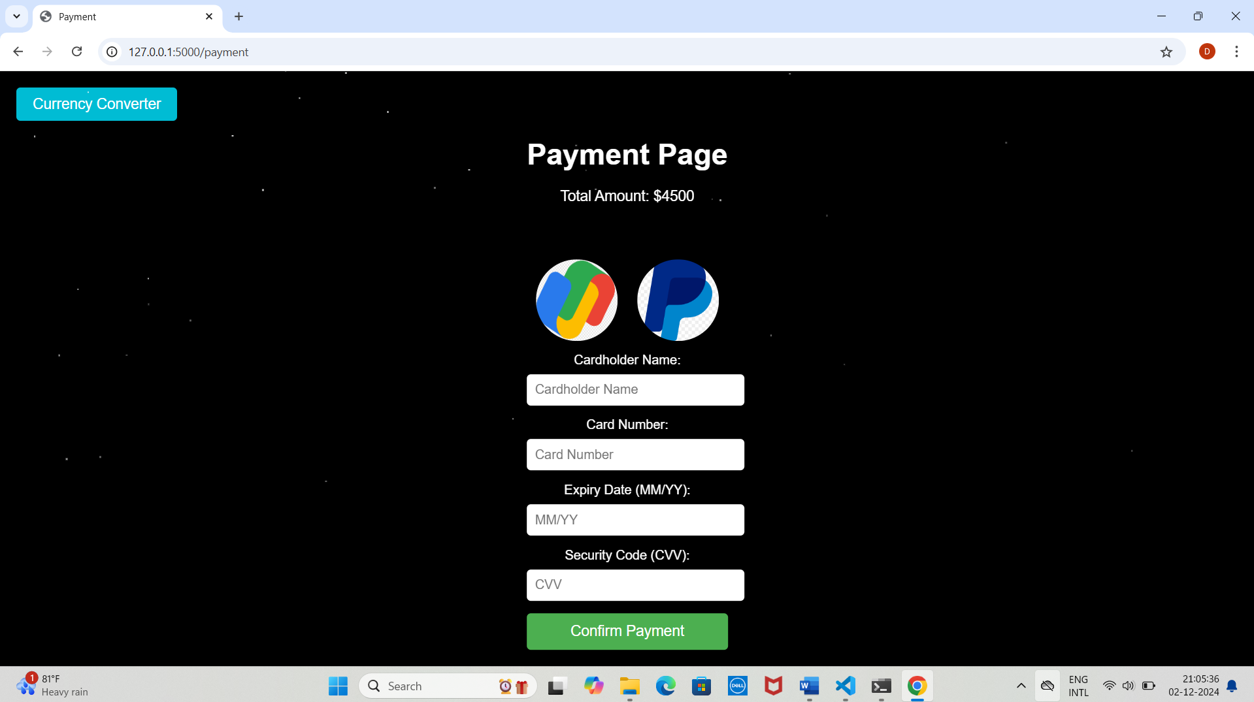
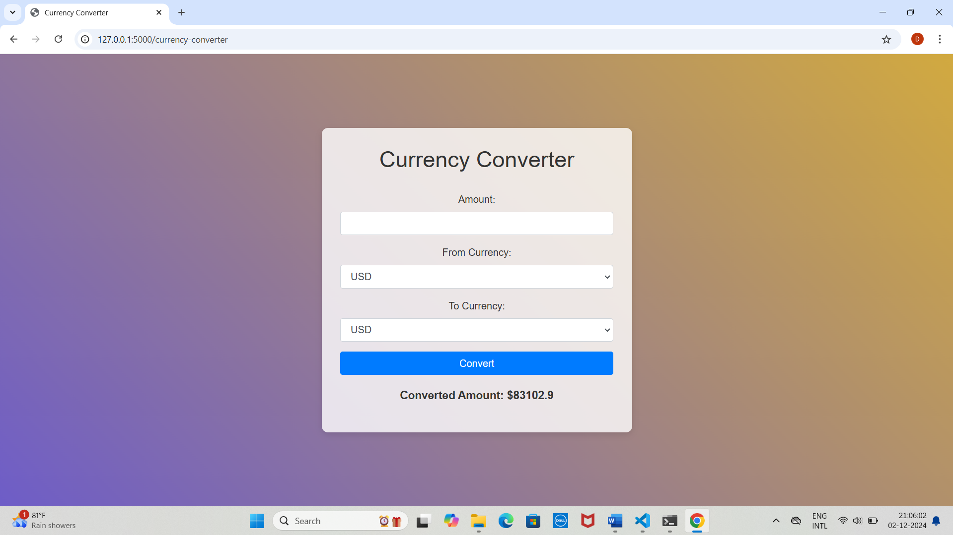
RESULTS AND DISCUSSION

Slide 16
CONCLUSION
Development of resort booking and tour management website offers
comprehensive solution to streamline the management of resorts and
tours.
By integrating key module such as user management ,payment processing and admin control the system provides a seamless experience for both customer and administrators.
The platform enhances efficiency , ensuring real-time availiability ,secure transaction and flexible booking option .
Overall this system contribute to better customer satisfaction, operational efficiency and business growth .
By simplifying the booking ,management process and for both resort and tours

Slide 17
THANK YOU

